Slide 1
BLAST
Basic Local Alignment Search Tool

Slide 2



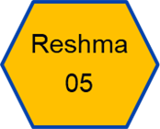
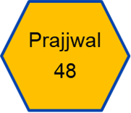



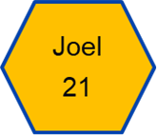
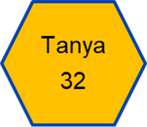
TEAM AVPR1A

Slide 3
TABLE OF CONTENTS
01
Prologue
02
BLAST Algorithm
03
Epilogue
04
Demonstration

Slide 4
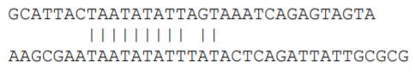
INTRODUCTION
Goal of genomics ---> to determine if a particular sequence is like any other sequence.
The alignment procedure uncovers those regions that are identical or closely similar and those regions with little similarity.
Alignment types : global and local
The global alignment looks for comparison over the entire range of the two sequences involved.
Notes:
An important goal of genomics is to determine if a particular sequence is like any other sequence. This is accomplished by comparing the new sequence with sequences that have already been reported and stored in a database [Click].
This process uses alignment procedure to uncover those regions that are identical or closely similar and those regions with little similarity. In a sense, these alignments are used to determine if a database contains a potential homologous sequence to the newly derived sequence [Click].
There are two alignment types: global and local [Click1][Click2]. The global alignment looks for comparison over the entire range of the two sequences involved. As you can see [point] only a portion of this two sequences can be aligned.

Slide 5
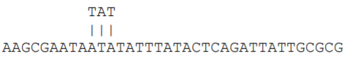
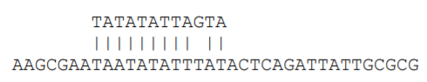
INTRODUCTION (Cont.)
In local alignment a small seed is uncovered that can be used to quickly extend the alignment.
The initial seed for the alignment:
Extended alignment:
Notes:
By contrast, when a local alignment is performed, a small seed is uncovered that can be used to quickly extend the alignment.

Slide 6
ABOUT BLAST
The Basic Local Alignment Search Tool (BLAST) finds regions of local similarity between sequences.
Query ---> new sequence
Target ---> set of many old sequences
Key idea of BLAST - Does not require individual alignments to be perfect.
Used to infer functional and evolutionary relationships between sequences and help identify members of gene families.
Notes:
The most common local alignment tool is the Basic local alignment search tool abbreviated as BLAST which finds regions of local similarity between sequences.
The BLAST algorithm looks at the problem of sequence database search, [Click] wherein we have a query, which is a new sequence, and [Click] a target, which is a set of many old sequences, and we are interested in knowing which of the target sequences is the query related to.
[Click] One of the key ideas of BLAST is that it does not require the individual alignments to be perfect; once an initial match is identified, we can fine-tune the matches later to find a good alignment which meets a threshold score[Click].
BLAST is used to infer functional and evolutionary relationships between sequences as well as help identify members of gene families.

Slide 7
BACKGROUND
BLAST is called the Google of biological research by The New York Times
The heuristic algorithm it uses is much faster than other approaches
Before BLAST, FASTA was developed by David J. Lipman and William R. Pearson in 1985.
BLAST came from the 1990 stochastic model of Samuel Karlin and Stephen Altschul.
BLAST is faster than any Smith-Waterman implementation but it cannot "guarantee the optimal alignments of the query and database sequences" .
BLAST with its various types is available on the NCBI website
Notes:
BLAST, which The New York Times called the Google of biological research, is one of the most widely used bioinformatics programs for sequence searching [Click]. The heuristic algorithm it uses is much faster than other approaches, such as calculating an optimal alignment [Click].
Before BLAST, FASTA was developed by David J. Lipman and William R. Pearson in 1985. Before fast algorithms such as BLAST and FASTA were developed, searching databases for protein or nucleic sequences was very time consuming because a full alignment procedure thats is Smith–Waterman algorithm was used [Click].
BLAST came from the 1990 stochastic model of Samuel Karlin and Stephen Altschul. They proposed "a method for estimating similarities between the known DNA sequence of one organism with that of another and their work has been described as "the statistical foundation for BLAST" [Click].
While BLAST is faster than any Smith-Waterman implementation for most cases, it cannot "guarantee the optimal alignments of the query and database sequences" as Smith-Waterman algorithm does [Click].
BLAST is more time-efficient than FASTA by searching only for the more significant patterns in the sequences, yet with comparative sensitivity. [CLICK] BLAST with its various types is available on the NCBI website. This will be further elaborated in the forthcoming slides. [Over to Joel]

Slide 8
BLAST ALGORITHM
SPLIT THE QUERY SEQUENCE INTO OVERLAPPING WORDS OF LENGTH K (K-MERS)
FIND NEIGHBOURHOOD OF EACH WORD
SELECT THOSE WORDS WHICH EXCEED A CERTAIN SCORE (SEEDS)
LOOK FOR LOCATION OF THESE SEEDS IN THE DATABASE USING A HASH TABLE.
EXTEND EACH SEED TILL THE SCORE OF ALIGNMENT DROPS BELOW A SPECIFIC THRESHOLD
REPORT MATCHES WITH OVERALL HIGHEST SCORES
Notes:
The first step of the algorithm is to split the query sequence into overlapping words of length K called K-mers. Lets see this in more detail. [CLICK]
The second step of the algorithm is to find neighbourhood of each word. Lets see how. [CLICK]
In the third step we select those words which exceed a certain score. These words are called seeds. Lets see it in more detail. [CLICK]
In the fourth step we look for location of these seeds in the database using a hash table. [CLICK]
In the 5th step we look into extension of each seed till the score drops below certain threshold [click]
In the last step, BLAST reports matches with the highest scores, which we will see during the demo [click]

Slide 9
SPLIT THE QUERY SEQUENCE INTO OVERLAPPING WORDS OF LENGTH K (K-MERS)
DTTGSQSLAALLNKCKTPQGQRLVNQWIKQNIIE
DTT
TTG
TGS
GSQ
SQS
…………………
IIE
Notes:
For example Lets take the query sequence as shown in the slide. And take the word size as 3. So starting from the beginning of the query sequence we generate words of length 3. [CLICK] The first word is DTT. For the second word we leave the first alphabet and [CLICK] use the next three i.e. TTG. For the next word we leave the first two alphabets [CLICK] and use the next three i.e. TGS and so on.
[CLICK 1]
[CLICK 2]
[CLICK 3]
[CLICK 4] The last word in the sequence will be IIE.

Slide 10
SPLIT THE QUERY SEQUENCE INTO OVERLAPPING WORDS OF LENGTH K (K-MERS) (contd)
DEFAULT LENGTH OF WORDS
NUCLEOTIDES : 28 (blastn)
PROTEINS : 6 (blastp)
BACK
Notes:
In standard BLAST the default length of words for nucleotides is 28 and for Proteins is 6.

Slide 11
FIND NEIGHBOURHOOD OF EACH WORD
DTTGSQSLAALLNKCKTPQGQRLVNQWIKQNIIE
DTT
TTG
TGS
GSQ
SQS
…………………
IIE
Notes:
We have already seen how we generate words from the search sequence. Now let us see how to generate the neighbourhood of a word. As an example lets take the word DTT. [CLICK]

Slide 12
FIND NEIGHBOURHOOD OF EACH WORD
DTT
ATT
BTT
CTT
DTT
……
ZTT
DAT
DBT
DCT
DDT
……
DZT
DTA
DTB
DTC
DTD
……
DTZ
BACK
Notes:
With respect to the word DTT, in the slide, we can [CLICK] see the various combinations of the word DTT. The alphabets in the first position have ben substituted by a different alphabet. [CLICK] In the second list the second alphabets have been changed and [CLICK] in the third list the third alphabets have been changed. Each of these words are scored as per scoring tables.

Slide 13
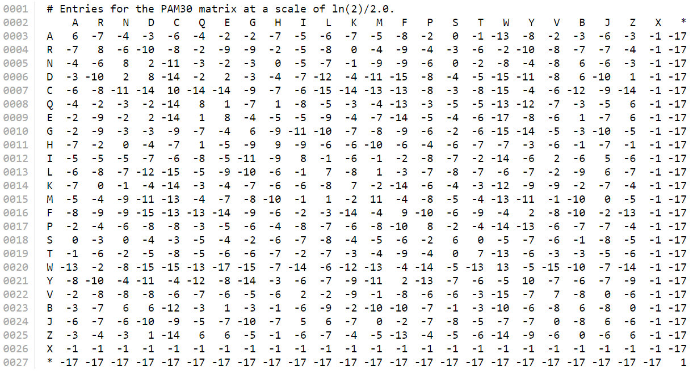
PAM 30
Notes:
O, U

Slide 14
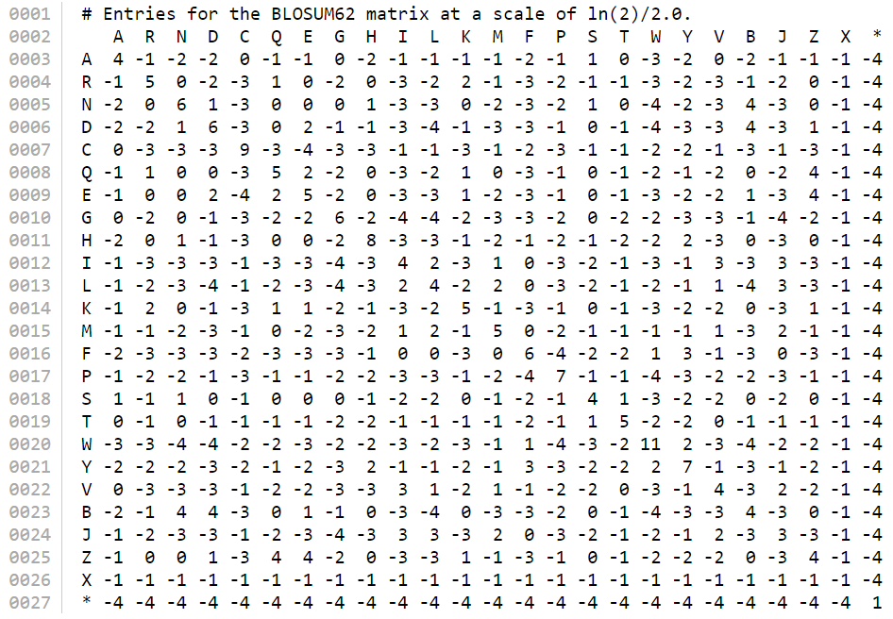
BLOSUM 62
Notes:
O, U

Slide 15
SCORING TABLES
TWO TYPES
PAM
BLOSUM
PAM – POINT ACCEPTED MUTATIONS: GIVES THE NUMBER OF MUTATIONS PER 100 AMINO ACIDS.
VARIANTS : PAM 30, PAM 100, PAM 120, PAM 160, PAM 200, PAM 250
BLOSUM – BLOCKS SUBSTITUTION MATRIX : GIVES THE %AGE IDENTITY OF THE PROTEINS USED.
VARIANTS : BLOSUM 45, BLOSUM 50, BLOSUM 62, BLOSUM 80, BLOSUM 90
Notes:
First lets look at how the scoring is done.
[CLICK] There are two types of scoring tables – PAM and BLOSUM. [CLICK] Pam stands for Point accepted Mutations. The table gives the number of mutations per 100 Amino Acids. [CLICK] The variants are PAM30, PAM 100, PAM 120, PAM 160, PAM 200 and PAM 250. This is what PAM 30 looks like. [CLICK]
[CLICK] BLOSUM stands for Blocks Substitution Matrix. The table gives the percentage identity of the proteins used. [CLICK] The variants of BLOSUM are Blosum 45, Blosum 50, Blosum 62 (which is the default table in Blast), Blosum 80 and BLOSUM 90.
BLOSUM matrices with high numbers like BLOSUM80 are designed for comparing closely related sequences, while those with low numbers BLOSUM45 are designed for comparing distant related sequences. This is what BLOSUM62 looks like. [CLICK]

Slide 16
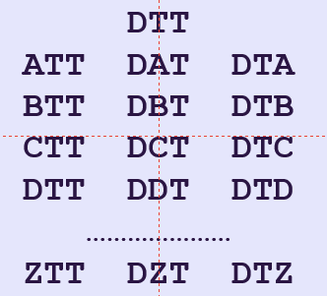
SCORING
D T T
| | |
A T T
-2+5+5 = 8
D T T
| | |
B T T
4+5+5 = 14
DTT - 8
BTT - 14
CTT - 12
DTT - 16
…..
ZTT - 15
DAT - 10
DBT - 13
DCT - 12
DDT - 15
…..
DZT - 7
DTA - 11
DTB - 9
DTC - 10
DTD - 14
…..
DTZ - 10
BLOSUM
BTT
DTT
…
ZTT
DBT
DDT
…
DTD
…
Notes:
Now lets score one transition – [CLICK] say DTT to ATT. To check the value for transition from D to A and from T to T, we refer to the BLOSUM 62 table[CLICK]. It is -2 for D to A and 5 for T to T. These values are substituted as shown and the score calculated. [CLICK] Lets calculate the score for another word transition – [CLICK] DTT to BTT. [CLICK] The value for transition from D to B is 4. [CLICK] and we already know the value of T. This adds up to 14.
Similarly we do the scoring for all words generated in the neighbourhood, which is as shown.
[CLICK1] This is for the words in the left column,
[CLICK2] This is for the words in the centre column and
[CLICK3] This is for the words in the right column.
Now we keep only those words whose score is above a certain threshold say 13.
The selected word can be seen in the boxes below the scored boxes. [CLICK1], [CLICK2] [CLICK3]

Slide 17
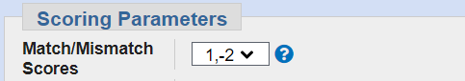
NUCLEOTIDES FIND MATCHES/MISMATCHES
FAIRLY SIMPLE
MATCH - POSITIVE VALUE OR HIGH SCORE
MISMATCH – NEGATIVE VALUE OR LOW SCORE
CAN BE SELECTED IN BLAST.
Notes:
Similarly, we carry out for nucleotides. [CLICK] For nucleotides the scoring process is fairly simple. [CLICK] For matches, a positive value or high score is allotted and [CLICK] for mismatches a negative value or low score is allotted. [CLICK] This value can be selected in BLAST. For example, here the cost for a match is 1 whereas for a mismatch the score is -2. We shall see the other settings when we see the demonstration phase of the presentation.

Slide 18
GAP COSTS
_
DB : LIA WHC MPN AAA
QUERY : IIA WHC A MPN DDA
10 + 28 + 18 + -2 = 56
AFFINE SCORING
GAP OPENING -10
GAP EXTENSION -2
DB : A _ A _ A _ A _ _ _ A A A A
QUERY : A A A A A A A A A A A A A A
-12 = 44
1 -12 1 -12 1 -12 1
-12 -2 -2 1 1 1 1
-32
-12
BACK
Notes:
Let us now look at how scoring is done when we have gaps. [CLICK] Consider the strain shown here. In the first line is the database strain with which we are comparing and in the second line we have the query sequence. The words WHC and MPN are the seeds. [CLICK] And once we extend we get score of 56. [Talk about the scores] But what about the spare A in the query sequence.
[CLICK] To deal with gaps there are two scores that we use which fall under the term of Affine Scoring. One is the gap opening cost. The other is the gap extension cost. Lets say the gap opening cost is -10 and the gap extension cost is -2.
[CLICK] Now lets consider the two database sequences given in the top line here, which we compare with two query sequences in the bottom line. In the first sequence, there are three missing sequences, whereas in the second there is only one missing sequence, in spite of the fact that the number of gaps in both the sequences are the same. Let us see what effect it has on the scoring.
Lets say the score of A to A is 1. [CLICK] Then for the first sequence the first A-A is 1. Then to open a gap there is a penalty of -10 and for the first insertion, penalty is -2 giving us -12. Then the next A to A is 1. Then to open the next gap, again, there is a penalty of -10 and for the first insertion penalty is -2. and so on. [CLICK] Here the score for the strain is -32.
[CLICK] Taking the second strain, to open the first gap the cost is -10 and for the first insertion it is -2 – i.e. -12. Now since the gap is already open for the next location the penalty is -2 for each of the contiguous gaps. [CLICK] Thus giving us a score of -12.
[CLICK] Now applying the same logic to the sequences given on the top of the slide, for opening a gap and inserting we apportion the penalty of -12, [CLICK] thereby giving is the score of 56-12 i.e. 44. This is called the row score.
This is how gap scoring is done.

Slide 19
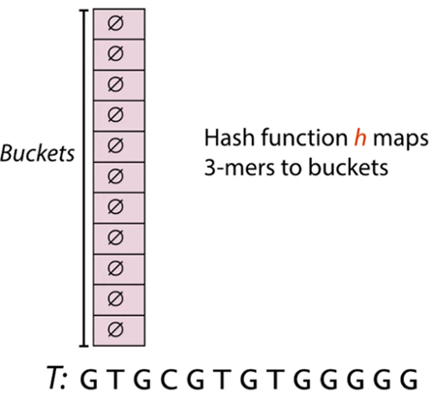
HASH TABLE and HASH FUNCTION
Initial value of Buckets = Ø
The Hash Function ‘h’ maps k-mers to the bucket.
Notes:
Now searching the entire database with all the combinations of the seed values becomes quite a tedious process. This is where the hash tables come into play. [CLICK] The hash table looks likes this and the pink cells in them are called buckets. [CLICK] These buckets have an initial value of null. [CLICK] And the hash function maps the k-mers to the bucket. Let’s considers a sequence here represented by the letter T and map the the sequence to the table.

Slide 20
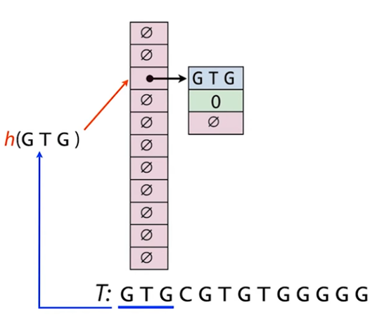
MAPPING THE K-MERS TO THE HASH TABLE
Notes:
When we have a sequence, we split it into the k-mers and send it to hash function. The hash function decides which element goes into which bucket. Here GTG is the key, 0 is the value which represents the offset that we got the k-mer from and there is a null reference at the end which is there to add in other elements to the list as and when required.

Slide 21
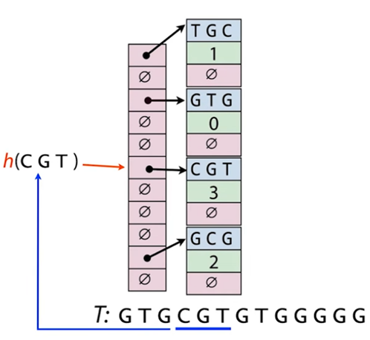
MAPPING THE K-MERS TO THE HASH TABLE
Notes:
We follow the same steps for the 2nd, 3rd and 4th offsets making the current structure look something like this.

Slide 22
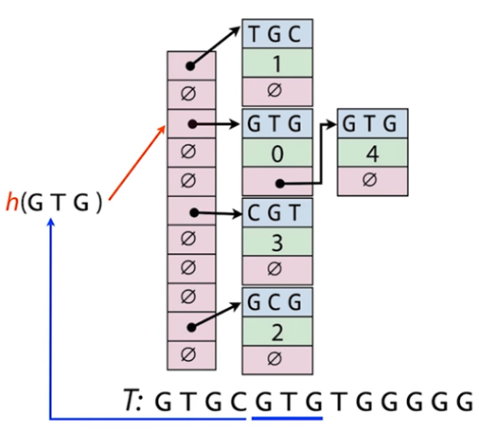
MAPPING THE K-MERS TO THE HASH TABLE
Notes:
When there is a same K-mer sequence, instead of assigning a new bucket, the key value pair is linked to the key-value pair that had been assigned earlier, making it a linked list.

Slide 23
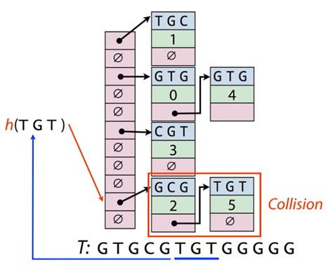
MAPPING THE K-MERS TO THE HASH TABLE
Notes:
Sometimes key-value pair that get linked are not the same, this happens due to less number of buckets available.The process can’t be avoided and doesn’t create a problem in the searching process. The only thing that increases due to this phenomena is the searching time. The concept is called the Pigeonhole principle. Let’s understand what it states.

Slide 24
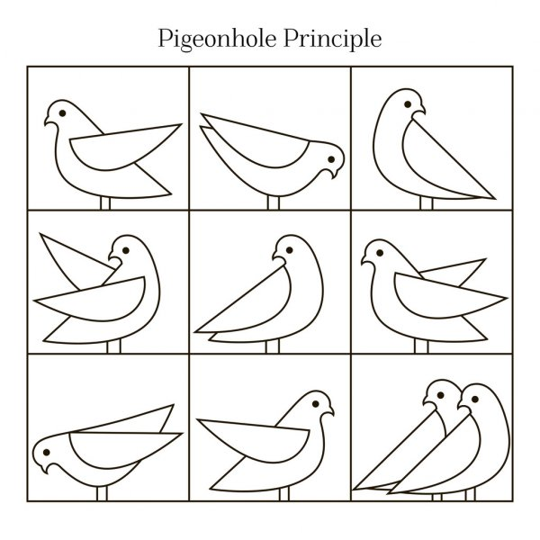
PIGEONHOLE PRINCIPLE
“If there are n pigeons and m holes, where n>m, there has to be at least one hole with more than 1 pigeons in it.”
Notes:
[Read the Principal]. The illustration on the right just proves the principle. So in this we have 10 pigeons and 9 boxes to keep them in. There has to be one box which has more than one pigeon in it.

Slide 25
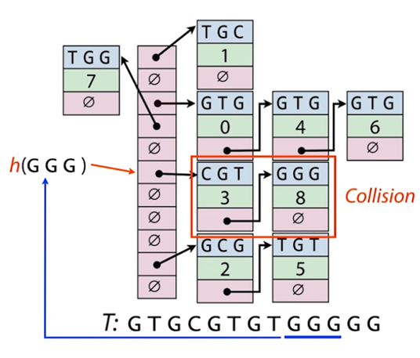
MAPPING THE K-MERS TO THE HASH TABLE
Notes:
Coming back to our example, we see that the hash function does a similar collision for the 8th offset.

Slide 26
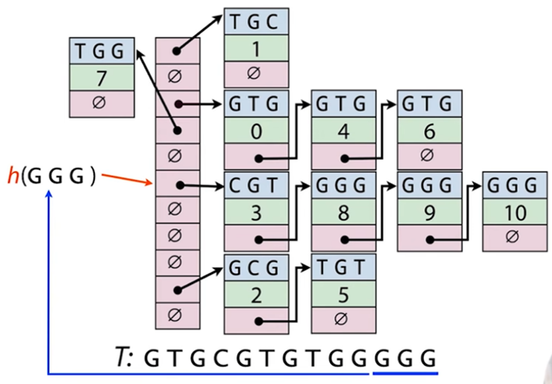
MAPPING THE K-MERS TO THE HASH TABLE
Notes:
And the process goes on till we reach the end of the sequence. And that is how a Hash Table is prepared for the entire database. It is now ready to be queried when any seed is passed to the Hash Function.

Slide 27
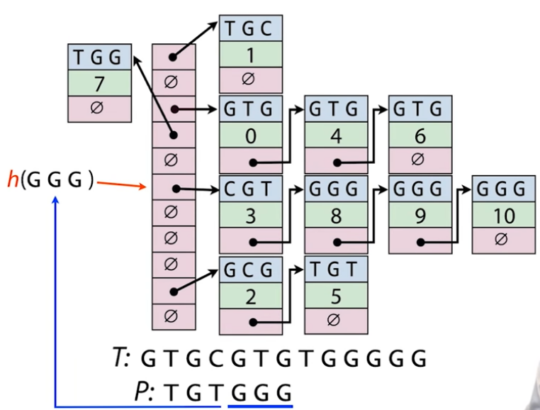
TESTING OUT THE HASH TABLE
Index hits at offsets [8,9 and 10]
Notes:
Say that we have another sequence represented by the letter P here, and we want to know the location of the k-mers in the hash table. As an example, let’s just look at the last 3-mer to be queried. The k-mer is send to the hash function and the hash function tells us which is the bucket we need to look into. Looking into the list present in the bucket we find that fist key doesn’t match the k-mer, but we go ahead anyway. And find that all the other k-mers have a hit. [CLICK] So the final index hits will be 8, 9 and 10 for this search.

Slide 28
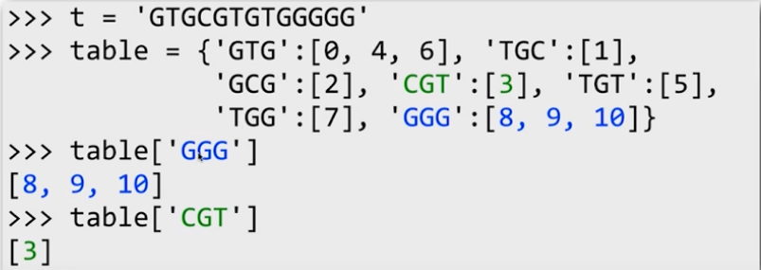
PYTHON REPRESENTATION OF THE SAME HASH TABLE
BACK
Notes:
Using Python creating a hash table becomes really easy, the data-structure called dictionary fairly represents what a hash table would look like. Here we can see that the variable T has the initial sequence with the help of which the hash table was created and then we have the table variable that has the hash key-value pairs. Now if you want to know the key values for a given k-mer you just put the value in the table variable and you get the index hits.

Slide 29
EXTENDING SEEDS
For each seed, alignment is extended in both directions
Stop when the drop in score falls below a certain threshold value.
QUERY
DATABASE QUERY
SEEDs
Notes:
After finding indexes for the seeds, we start extending each seed in both the directions individually [click] till the drop in score falls below a specific threshold.
[click] Lets visualize the extensions here. We have a query sequence
[click ] and its database segment with which we ae trying to match.
[click] let’s assume there are two seeds
[click] To get the high score segment we start extending the alignment in both the directions, which is comparing the alphabets of the query strain and the database strain.
Lets understand how it is done and how the threshold or drop off value is applied.

Slide 30
EXTEND EACH SEED TILL SCORE OF ALIGNMENT DROPS BELOW A SPECIFIC THRESHOLD
QUERY = Y A N C Q E H K M G S Max Drop off score, X = 2
Extend in the right direction
Q E H K M G S
D A P C Q E H K R G W P N D C
5 5 8 5 -1 6 -3
5 10 18 23 22 28 25
Score Drop = 3 > X
Notes:
Let’s assume the seed for our example here is QEH in the given search sequence as shown and the max drop off value is 2.
[click ] Extending to the right, we compare the search sequence, given in the top line, with the alphabets in the database sequence, given in the bottom line, and calculate the score using BLOSUM62.
[click] The score for Q to Q is 5, E to E is 5, and H to H is 8 making the total to 18, which is the starting score for the seed.
Matching K to K we get the score 5 making the total 23. Since there is no drop in the score, we continue extending. Next, for M to R score is -1 making a drop in the score to 22. Since the drop of 1 is less than the threshold drop-off value of 2, we continue extending. Next, matching G to G we get a score of 6 making the total 28. Moving right, we now compare S to W getting a score of -3 making the score 25. Now, [CLICK] since the drop in value is 3, which is more than the threshold drop off value of 2, our extension stops here.
Hence, we find our terminating point for extension to right. And trim the [CLICK] right alignment at G at the score of 28.
Progressively moving to the right, in this case, while comparing the alphabets and scoring the segment is called Extending.

Slide 31
EXTEND EACH SEED TILL SCORE OF ALIGNMENT DROPS BELOW A SPECIFIC THRESHOLD
QUERY = Y A N C Q E H K M G S Max Drop off score, X = 2
Extend in the left direction
Y A N C Q E H
D A P C Q E H K R G W P N D C
-3 4 -2 9 5 5 8
26 29 25 27 18 13 8
Score Drop = 3 > X
Notes:
Similarly, we follow the previous steps again for extending to the left and we get terminating point while going from Y to D. Hence we trim our alignment at A.
Take a few seconds to absorb the slide.

Slide 32
MAXIMAL SEGMENT PAIR
A N C Q E H K M G
A P C Q E H K R G
4 -2 9 5 5 8 5 -1 6
Score = 4 - 2 + 9 + 5 + 5 +8 + 5 - 1 + 6 = 39
Notes:
The result of extending in both directions is a pair of sequences called a maximal segment pair or MSP. Following the same procedure for all the seeds we find all the MSPs. In the instance flashed in front of you, the score of the MSP is 39.

Slide 33
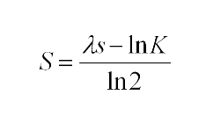
E- VALUE
Converting raw score to bit score :
λ , K = constants that depends on scoring matrix and gap penalties
2. Normalisation equation based on k, m ( length of db), n(length of query) is used to find E-value
E = kmne^{-λs}
Notes:
All the scoring matrices are different and for each scoring matrix we get different pairwise scores.
[click] Bit score is used to normalise the raw score based on the different parameters. This makes score much more comparable between different matrices.
[click] Bit score is calculated using formula ---- where [click] lambda and k are constants
Now with the bit score we can’t compare with the length of query and length of database, to get false positive rate or no error rate.
[click] In this case we calculate E- value. E-values are very dependent on the query sequence length and the database size.
[click] this is calculated using formula -----
The expectation value(E-value) can be changed in order to limit the number of hits to the most significant ones.

Slide 34
E-VALUE (Contd.)
Some rules of thumb which can be used as a guide :
E-value < 10⁻¹⁰⁰ Identical sequences.
10⁻⁵⁰ < E-value < 10⁻¹⁰⁰ Almost identical sequences
10⁻¹⁰ < E-value < 10⁻⁵⁰ Closely related sequences, could be a domain match or similar.
1 < E-value < 10⁻⁶ true homologue but it is a gray area.
E-value > 1 Proteins are most likely not related
E-value > 10 Hits are most likely junk unless the query sequence is very short
BACK
Notes:
The lower the E-value, the better the hit. Short identical sequence may have a high E-value and may be regarded as "false positive" hits. Increasing this value will most likely generate more hits.
Here we can see some range of E-value indicating certain characteristic about the sequence

Slide 35
USES OF BLAST
● Identifying Species - possibly correctly identify a species or find homologous species.
● Looking for domains - locate domain of a protein sequence.
● Establishing phylogeny - create a evolution tree using the BLAST
web-page.
● DNA Mapping - map a gene sequence at an unknown location with relevant sequences.
● Comparison - locate common genes in two related species.
Notes:
Now let’s look at the USES OF BLAST
BLAST can be used for several purposes. These include the following points:
[CLICK] First is Identifying species - With the use of BLAST, you can possibly correctly identify a species or find homologous species. This can be useful, for example, when you are working with a DNA sequence from an unknown species.
[CLICK] Second use is Locating domains - When working with a protein sequence you can input it into BLAST, to locate known domains within the sequence of interest.
[CLICK] Third use is Establishing phylogeny - Using the results received through BLAST you can create a evolution tree using the BLAST web-page. Phylogenies based on BLAST alone are less reliable than other phylogenetic methods.
[CLICK] Fourth use is DNA mapping - When working with a known species, and looking to sequence a gene at an unknown location, BLAST can compare the chromosomal position of the sequence of interest to relevant sequences in the database. NCBI has a "Magic-BLAST" tool built around BLAST for this purpose.
[CLICK] Last use is Comparison - When working with genes, BLAST can locate common genes in two related species, and can be used to map annotations from one organism to another.

Slide 36
TYPES OF BLAST
 |  | DATABASE
 |  | DNA | Protein
Q U E R Y | DNA
 | Protein
BLASTn
BLASTx
tBLASTx
tBLASTn
BLASTp
Notes:
Now let us see the TYPES of BLAST searches.
[CLICK] To compare a DNA query to a DNA database, we use BLASTn. It searches both strands automatically. It is optimized for speed, rather than sensitivity.
[CLICK] To compare a protein query to a protein database, we use BLASTp.
[CLICK] To compare a DNA query to a protein database, we use BLASTx
[CLICK] To compare a protein query to a DNA database we use tBLASTn.
[CLICK] To compare the protein encoded in a DNA query to the protein encoded in a DNA database we use tBLASTx
There are many other types of blast as well.
The reason to use these many algorithms is that we want to look for very similar things in searches in both DNA and protein.

Slide 37
BLAST ALTERNATES
FASTA
PLAST
BLAT
MMseqs
Predecessor to BLAST
For comparing two banks of sequences
An extremely fast but considerably less sensitive alternative
Faster, improvements on current search tools
Notes:
There are several ALTERNATES to BLAST.
[CLICK] First is FASTA stands for fast-all” or “FastA” algorithm – it is inferior to BLAST in its speed and accuracy. It is better applied only for dissimilar sequences, but not for closely matched sequences.
[CLICK] Next is BLAT which stands for Blast Like Alignment Tool is an extremely fast but considerably less sensitive alternative to BLAST which relies on k-mer indexing of the query, and thus can often find seeds faster.
[CLICK] An alternative to BLAST for comparing two banks of sequences is PLAST which stands for Parallel local alignment search tool . PLAST provides a high-performance general purpose bank to bank sequence similarity search tool. Results of PLAST are very similar to BLAST, but PLAST is significantly faster and capable of comparing large sets of sequences with a small memory footprint.
[CLICK] Next is MMseqs , an open-source software which improves on current search tools over the full range of speed-sensitivity trade-off, achieving sensitivities better than PSI-BLAST at more than 400 times its speed.

Slide 38
ACCELERATED VERSIONS
There are HARDWARE accelerated versions of blast.
FPGA Accelerated:
FPGA accelerator
GPU Accelerated
GPU-Blast
CUDA-Blast
G-BlastN
CPU Accelerated
MPIBlast
CaBlast
Paracel Blast
Notes:
Let’s look at the Accelerated versions of blast:
[CLICK] There are hardware specific accelerated version of blast. The best performing accelerated implementation of the BLAST algorithm on the market today is Tera-BLAST offered by a company called TimeLogic which is hundreds of times faster.
Other formerly supported types of versions include:
[CLICK] FPGA-accelerated:
FPGA stands for Field Programmable gate array which includes a version called as FPGA accelerator.
[CLICK] Next supported version type is GPU-accelerated which includes GPU-Blast, CUDA-Blast, G-BlastN.
[CLICK] Another supported version type is CPU-accelerated which are MPIBlast, CaBlast, Paracel Blast.

Slide 39
CONCLUSION
Simple and robust
Approach allows construction of fast programs.
Advantage of flexibility
Easy Accessibility
Notes:
The concept underlying BLAST [CLICK] is simple and robust and therefore can be implemented in a number of ways and utilized in a variety of contexts. [CLICK] The BLAST approach permits the construction of extremely fast programs for database searching that have the further [CLICK] advantage of its flexibility to amend for mathematical analysis. Most importantly, BLAST has helped to establish bioinformatics analysis and [CLICK] make it accessible to any researcher over the Internet. In short, BLAST and it's descendant applications have permitted scientists to predict the functions of genes and proteins in whole genomes.
Now we will see a demonstration of blast.

Slide 40
THANKS!
Do you have any questions?
Team AVPR1A

